Slide 1

Boeing Frontiers: A New Beginning
By: Armaan Shivpuri, Paolo Bahrami,
Clinston Zeng, and Ryan Paillet
Notes:
Armaan

Slide 2

The Problem
Problem: The Difficulty of Building a Network Within Boeing as an Intern & Employee
  Importance of Networking in Internship
  Difficult to Network in Virtual Environment
  Current/Past Interns
Notes:
Armaan

Slide 3

Our Solution
'Boeing Frontiers’
  Software
    Slack
    Linkedin
    Facebook
  Helps Connect
    Employees with Interns
    Employees with Employees
    Interns with Interns
  Benefits
    Security
    Simplicity
    Formality
Notes:
Armaan

Slide 4

Boeing Frontiers:
Connecting Interns with Mentors
Social Networking Platform for employees and interns.
  Auto matching System: Recommends employees to interns based on interest areas
  Match potential mentors/interns based on a search criteria
    Department
    Job title
    Past experiences
  Facilitated communication between Mentors and Students
    Instant Messaging
    Group Chats
    Notifications
    Schedule Meetings
    Mobile Support
Notes:
Clinston

Slide 5
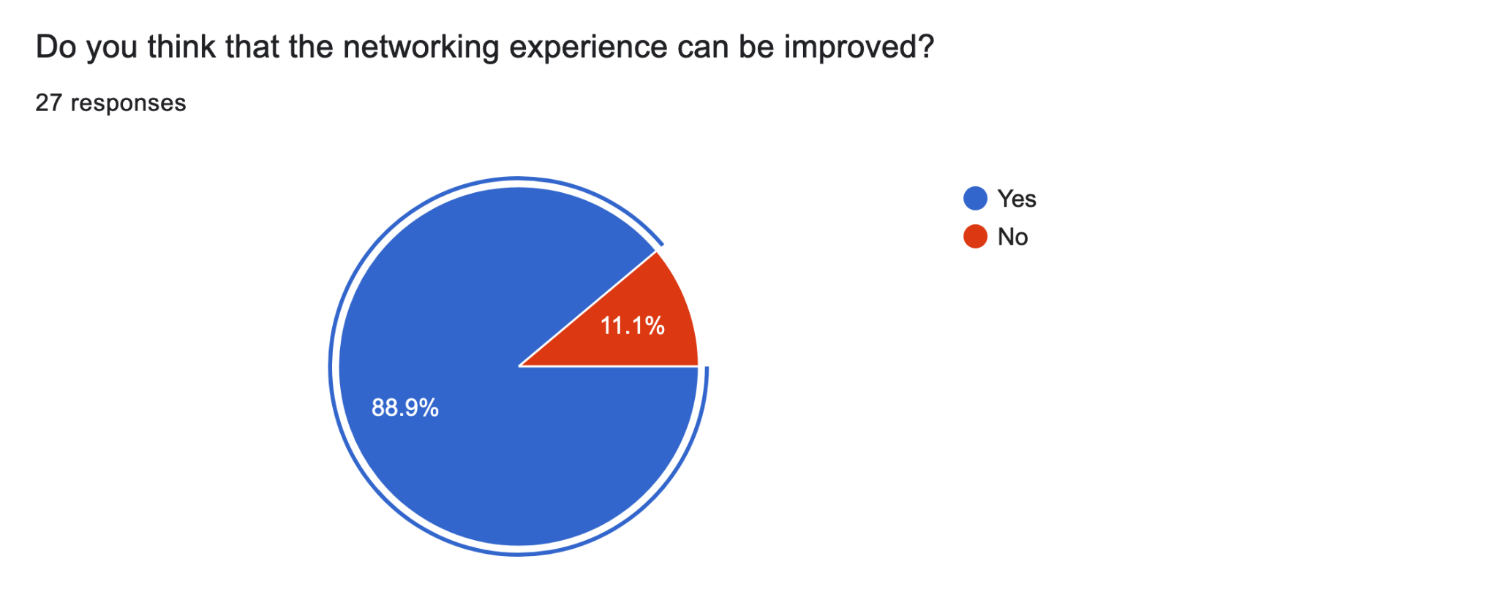
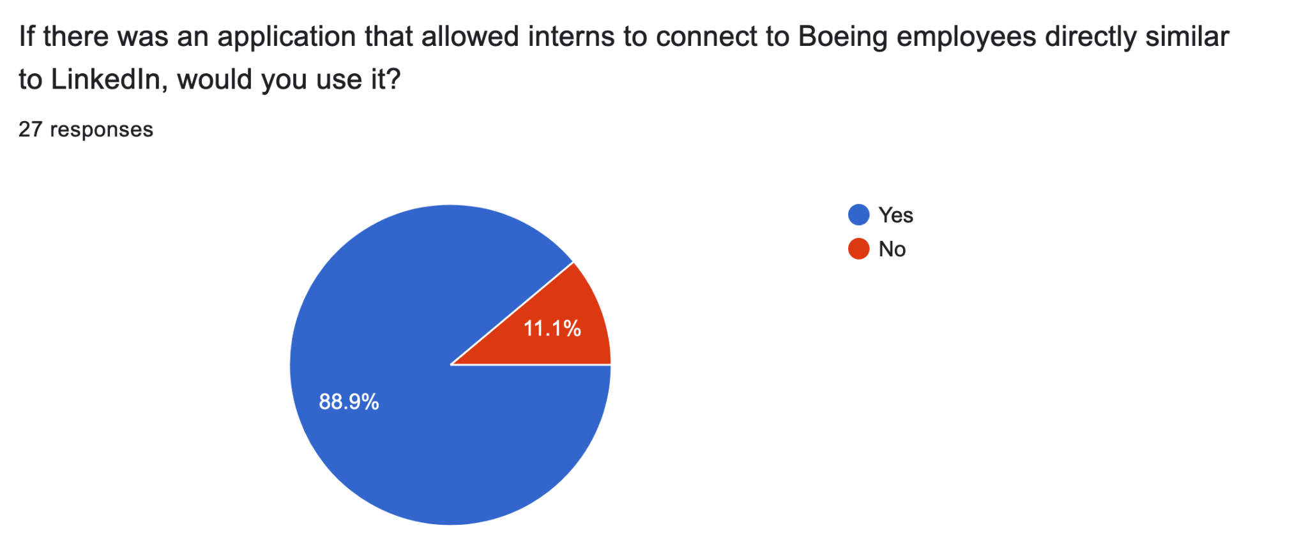
Student Survey Data
“I think the best way to improve the networking experience is to allow the intern to search for the particular person they want to reach out to rather than asking Charlie for a list of people. It is not difficult for the interns, but it adds a lot of time for Charlie and other coordinators across the nation.”
Anonymous Intern
“I don't think networking is very easy because I have tried to network with people, and they are either unavailable or don't reply. The back and forth emailing situation isn't always the best.”
Anonymous Intern
Notes:
Clinston
Survey after presenting the idea
Add student responses & employee responses here
Add positive sections of the survey

Slide 6
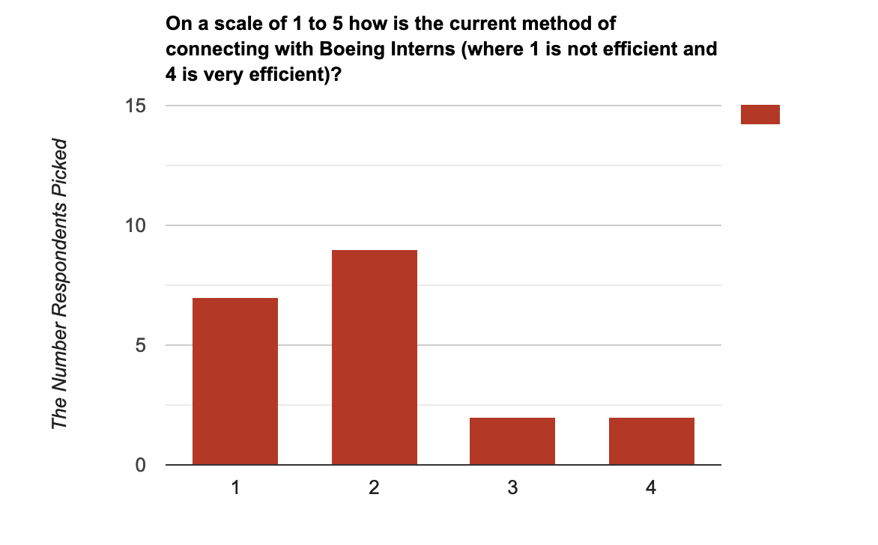
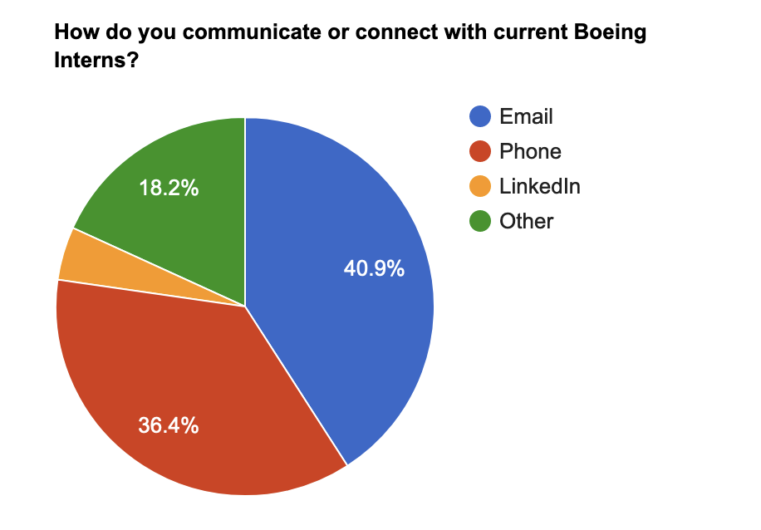
Employee Survey Data
“One of the main ways I have been introduced to interns is through mutual connections in Boeing. However, I feel this is a lucky coincidence and there aren’t sustained resources/databases…..”
Anonymous Employee
“I’ve had instances where I referred a HS intern to someone else and the fact they were external made the person hesitant to connect/respond. So, if there was a way to tangentially prove association with Boeing even as a HS intern that would be an improvement.”
Anonymous Employee
Notes:
Clinston
Add quotation to script
Survey after presenting the idea
Add student responses & employee responses here
Add positive sections of the survey

Slide 7
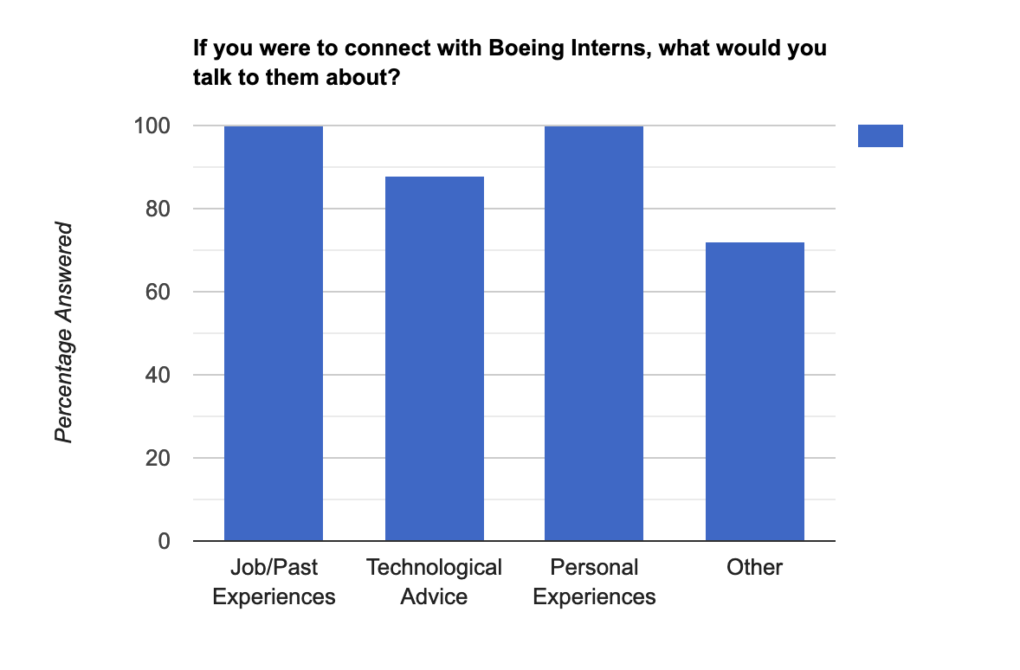
Employee Survey Data
“There isn’t an easy way that identifies points of contact across the company within specific areas or people who have certain experiences/skillsets. Example: if I wanted to contact a refurbishment expert on a military aircraft program, I wouldn’t know where to start other than talking to the co-workers on my program and hope that they know someone who knows someone who knows someone.”
Anonymous Employee
“Right now Insite Org Charts don’t always give a good perspective of the job role that someone plays. For example, [an] IPT in Common Products would not be shown as associated with any of the team members of the products they support. So having a method that you could flag co-workers would allow someone to more easily trace members of a team and find who they need or want to talk with.”
Anonymous Employee

Slide 8

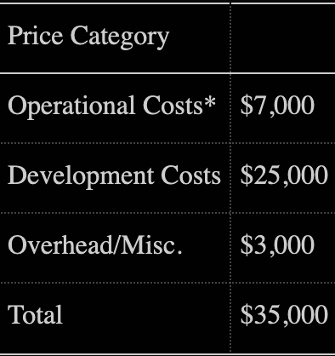
Cost Analysis - Similar Platforms
Slack (150k development costs - Ours costs 80% less)
LinkedIn (80k development costs - Ours costs 62.5% less)
Discord (60k development costs - Ours costs 50% less)
Twitter (100k development costs - Ours costs 60% less)
  Approach similar to recent IPOs Doximity in specialty
_____________________________________________________
Advantages via Cost: Specialty Target Market, Intern Help, Demonstrated Interest, Improved Transparency
Notes:
Ryan

Slide 9
Cost Analysis - Year on Year End
72.14 %
7.38 %
Quality Assurance: Interns - Free
Project Management - Incorporate Existing Structures
9.52%
10.96 %
Approximate Development Cost
Project Management
Workflow Overhead - Servers not needed year round
UI/UX Design
Overhead
Notes:
Ryan

Slide 10
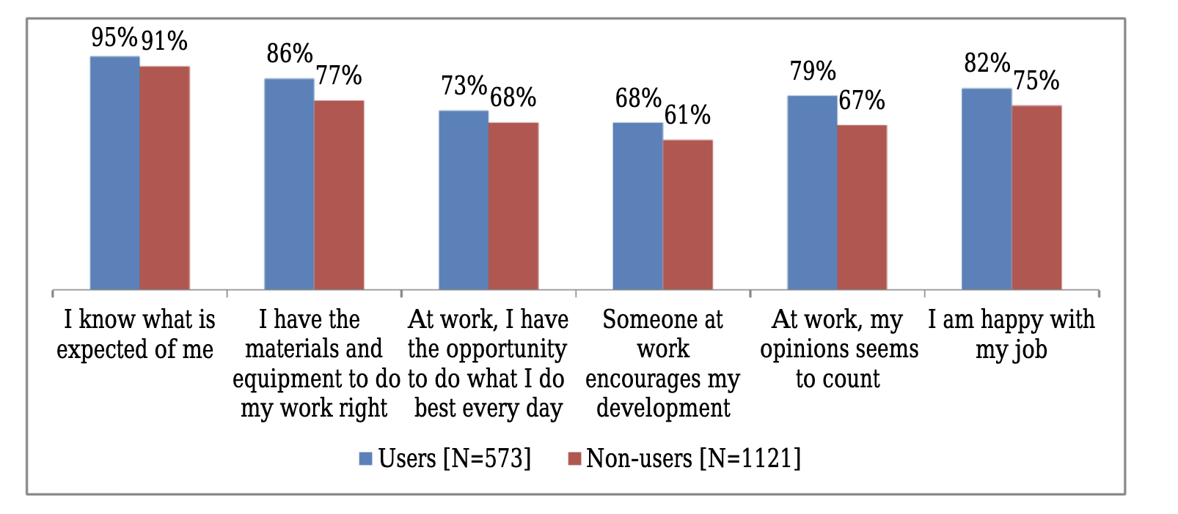
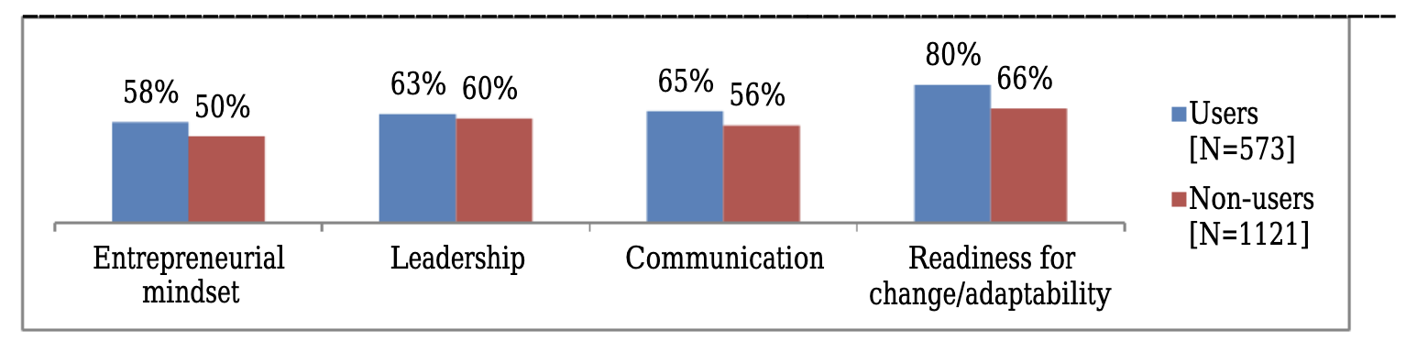
Benefits
Increased Productivity
Increased Transparency
Increased Employee Morale
Greater Retention of Interns
Notes:
Ryan

Slide 11
Implementation: Timeline
Phase 1 (3 months to 8 months)
Phase 3 (1 month)
Phase 2 (3 months)
Phase 4 (start of program overhead, maintain with updates as needed)
Implementation of Boeing Frontiers into Boeing workflow
Ready for rollout to all users
Complete coding and installation of program w/ Interns
Quality Assurance & Bug Testing with Interns/Select Mentors
Notes:
Ryan

Slide 12

Implementation - Associated Risks/Mitigation
Risks:
Adaptability & Adoption are not widespread, two few mentors/employees to engage
Program lacks support
Content is repeated from multiple sources
Mitigation:
There will always be a market and a set number of users
Internship is valuable to students, students can contribute to the updating of the code
Centralization of all assignments & ideas should be stressed
Notes:
Ryan

Slide 13

Frontiers: Why It Is Necessary
Special designed for mentors and students to communicate easier
  Suitable for both younger students and more mature mentors
Embedded with Boeing Directory Service
  Able to lookup Boeing employee by name, department, etc.
Can Schedule Meetings
Mobile and Desktop Support
Product created by Boeing Interns
Notes:
Clinston

Slide 14
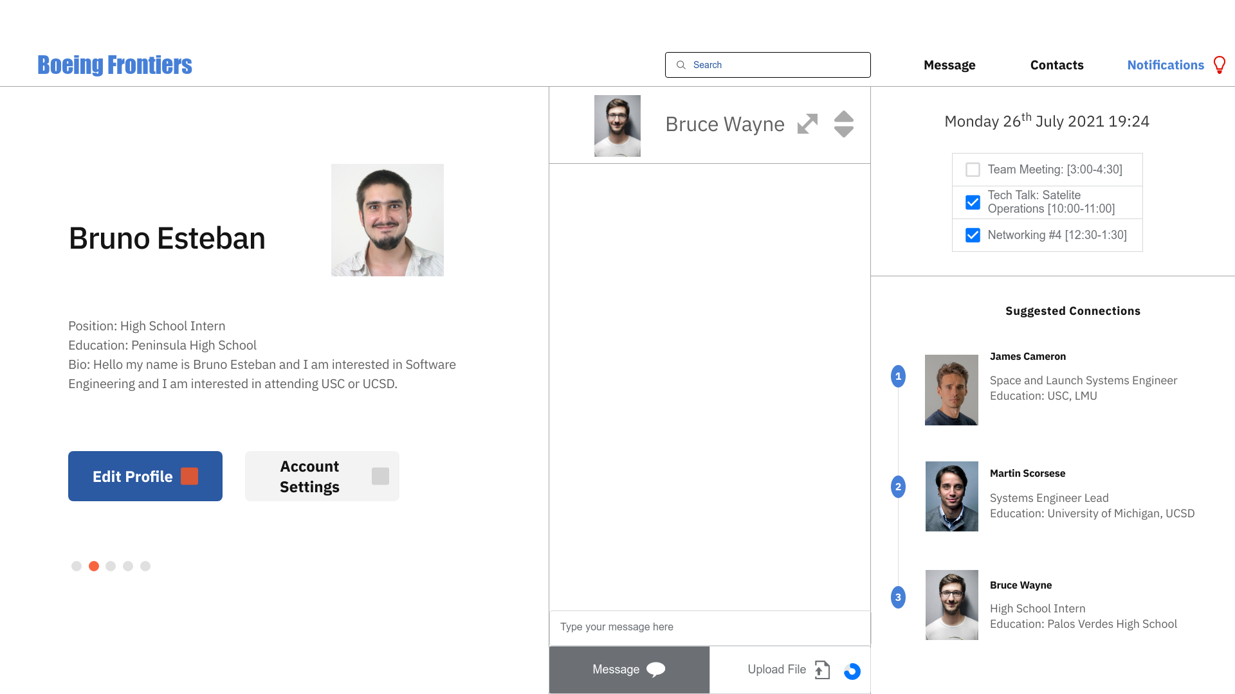
Visuals
Notes:
Paolo

Slide 15
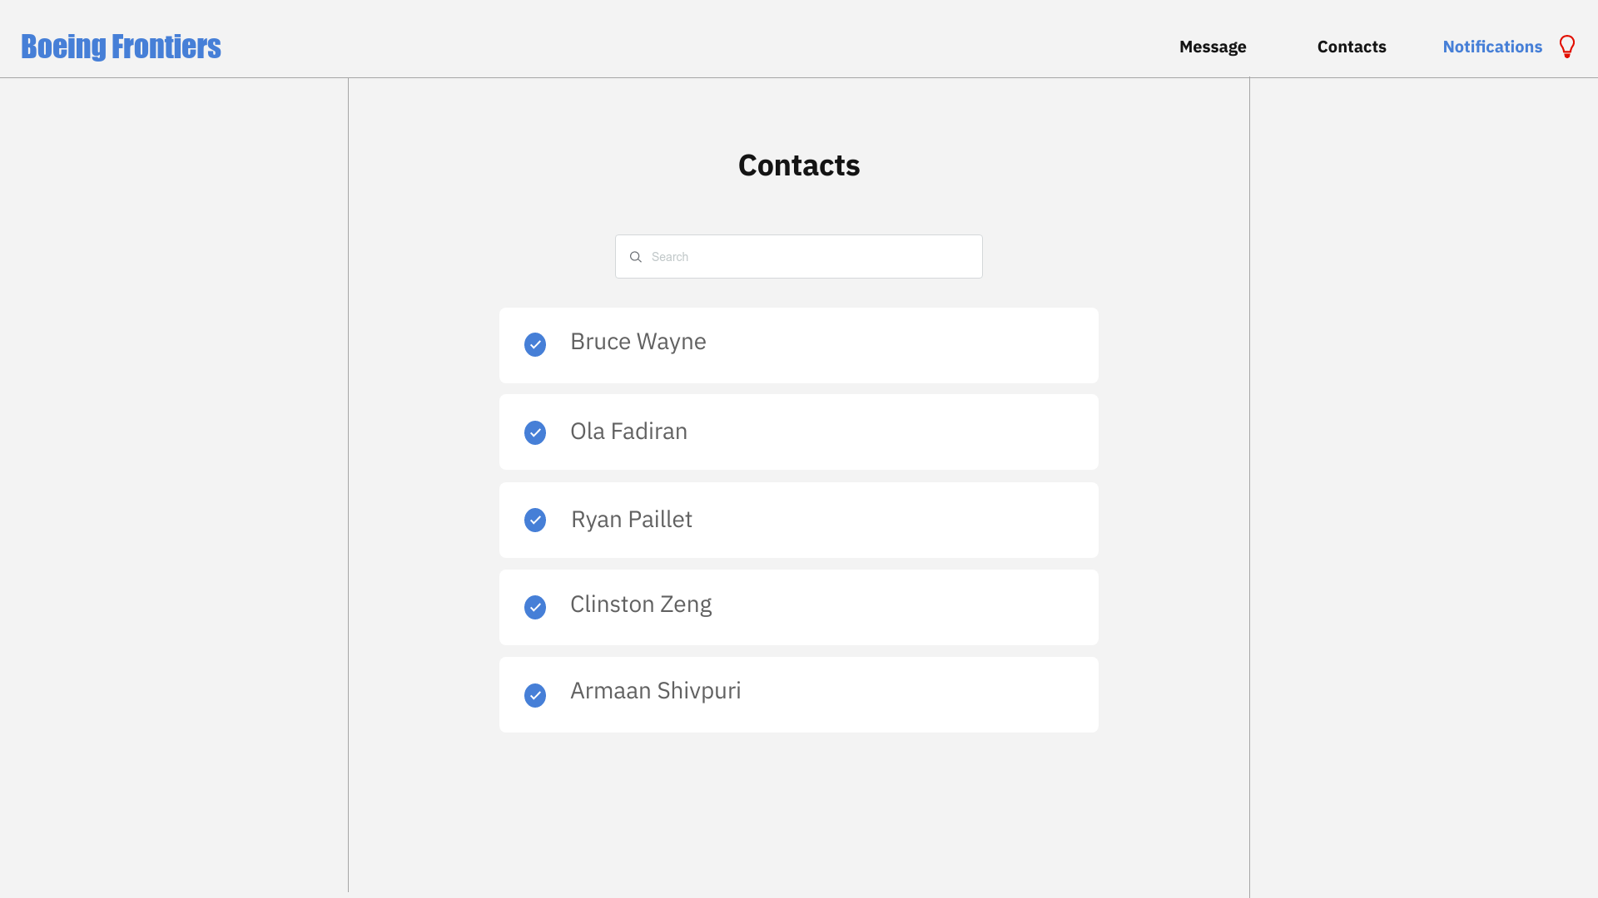
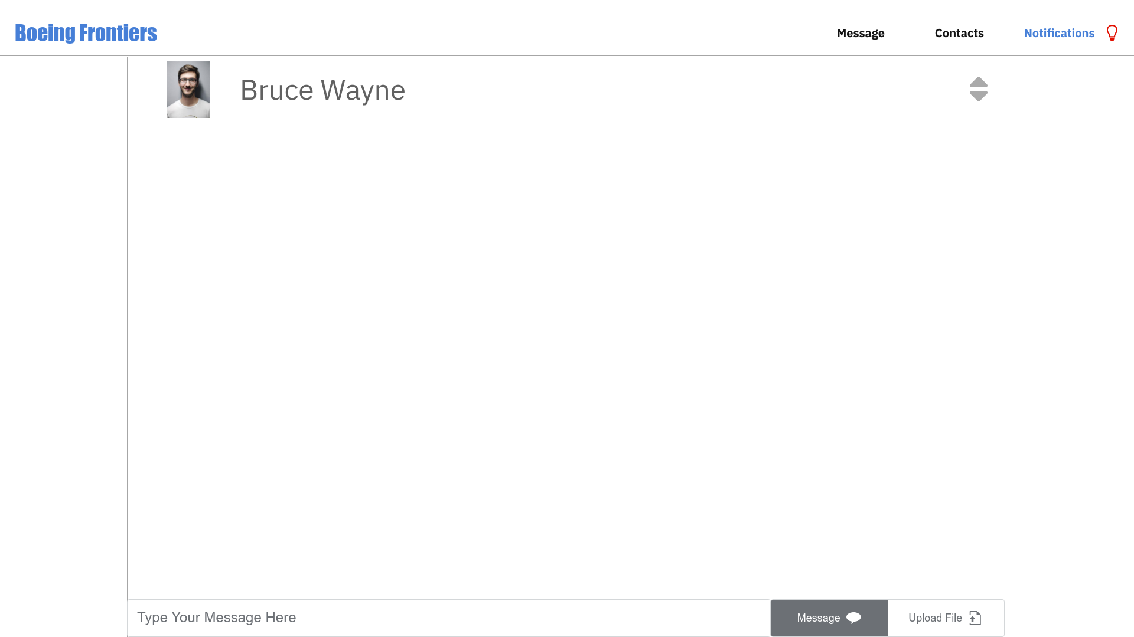
Visuals
Notes:
Paolo

Slide 16

The Algorithm
Notes:
Paolo

Slide 17

Thank you for listening!
Next Steps:
Program a rudimentary UX/UI design and implement the algorithm
Host or distribute information to all Boeing Employees and Interns on the software and gauge responses
Add more functionality & incorporation into Boeing specific workflow
Bibliography:
DiPolo, Meagan. “Internal Social Media Boosts Employee Engagement and Trust.” Institute for Public Relations, 28 Jan. 2021, instituteforpr.org/internal-social-media-boosts-employee-engagement-and-trust/.
Men, Linjuan Rita, et al. “Examining the Effects of Internal Social Media Usage on Employee Engagement.” Public Relations Review, JAI, 24 Jan. 2020, www.sciencedirect.com/science/article/abs/pii/S0363811120300011.
“A Spiral of Voice? When Employees Speak up on Internal Social Media.” Journal of Communication Management, www.emerald.com/insight/content/doi/10.1108/JCOM-03-2019-0050/full/html.
Notes:
Ryan

Slide 18


Discord and Email
Discord:
  140 million+ active users
  Popular among teens
  Includes features not interested for adult users
    Custom emoji integration
    Customizable theme-focused chat groups
    Integration with Video Games
Lacking integration with Boeing Directory Service
  Cannot look up people based on name/title
  Cannot Schedule Meetings
Widely used in Business and Professional Setting
  Almost everyone has an email account
  Communication Record
    Sent/Receive Email Records
    Forwarding
  Not widely used as primary communication channel among teens
    Many teens don’t check their email
  No instant messaging for most email clients
  Not widely used on mobile devices
    Many teens exclusively communicate using phones
Notes:
Backup Slide

Slide 19
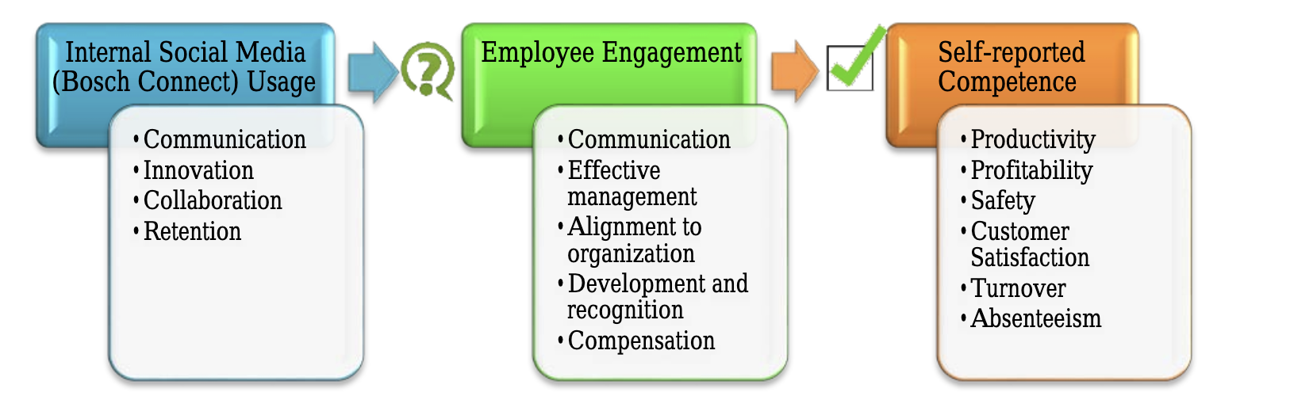
01
02
03
Quality of Life
Program Functionality
Market Research
Cost Analysis - Testing & Designing
In creation of the program, how will we incorporate diverse ideas?
Provides an opportunity for future interns to utilize, help push the program forward
Will there be widespread adoption of such a program?
Will it accomplish its intended goal?

